Slide 1
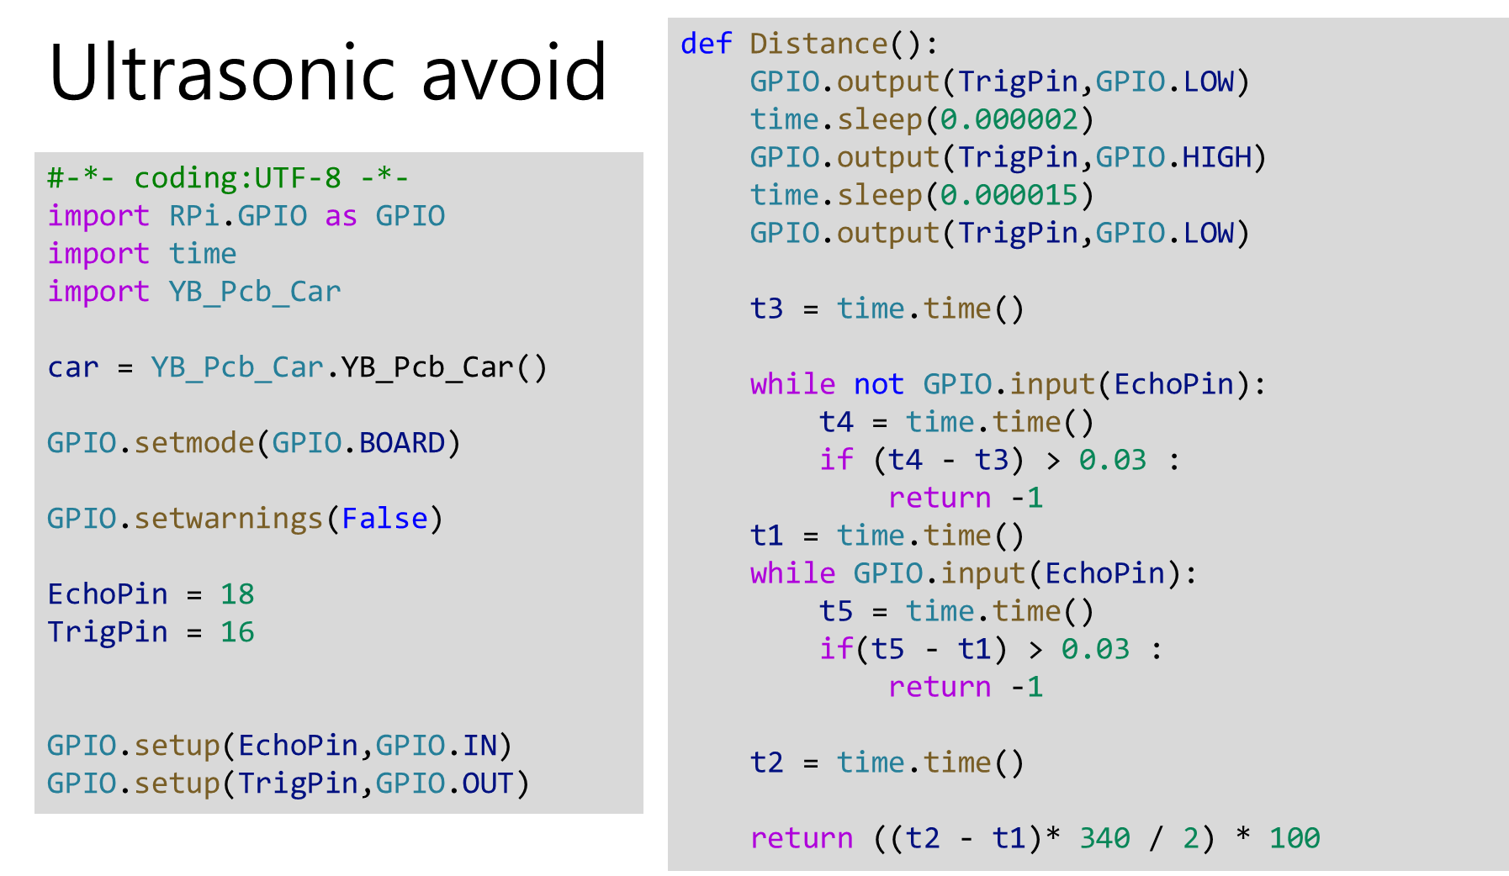

Slide 2
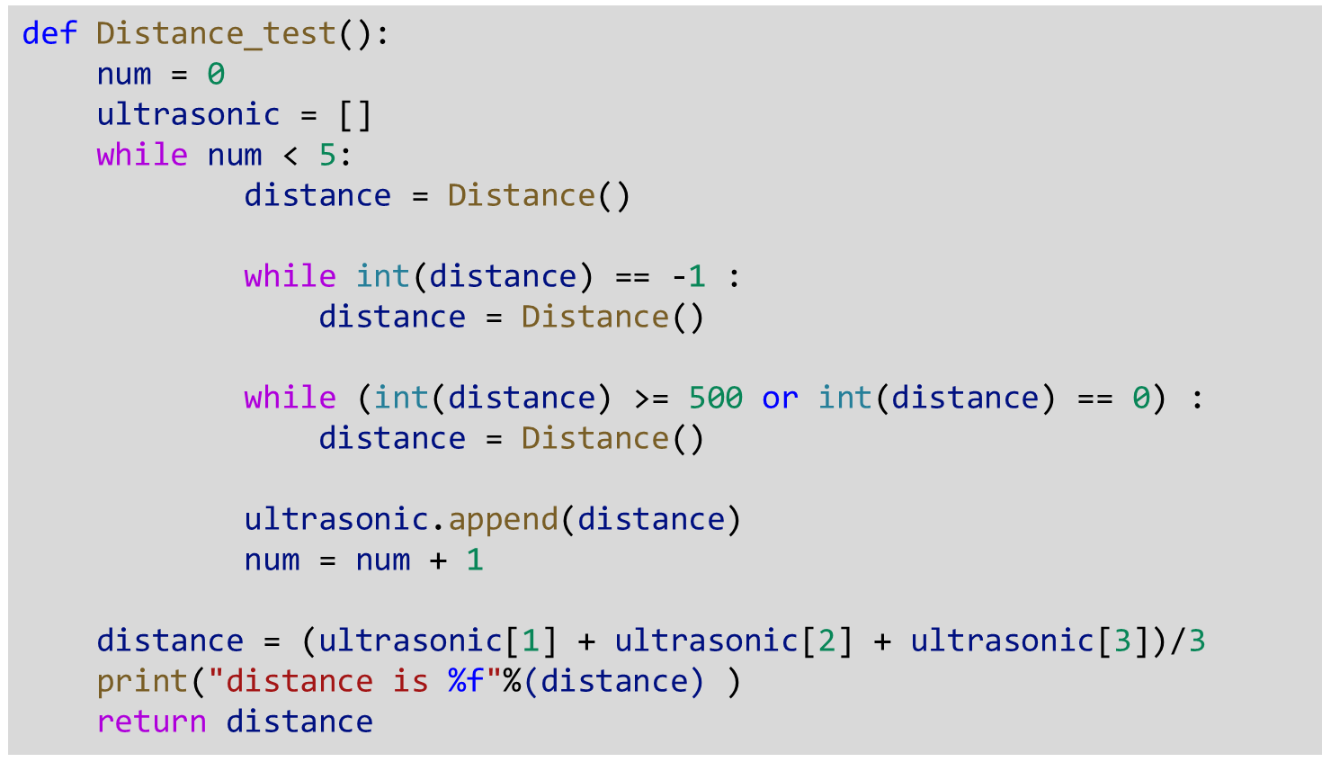

Slide 3
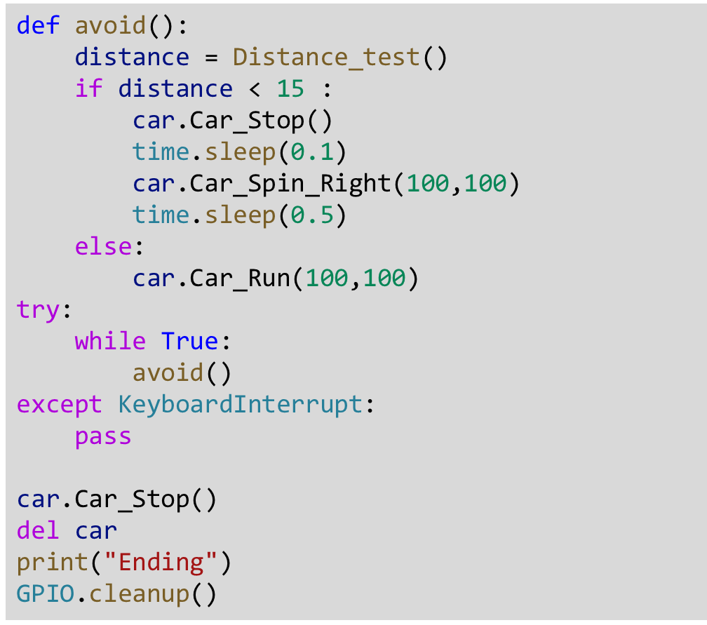

Slide 4
def avoid():
distance = Distance_test()
if distance < 15 :
car.Car_Stop()
time.sleep(0.1)
car.Car_Spin_Right(100,100)
time.sleep(0.5)
else:
car.Car_Run(100,100)
try:
while True:
avoid()except KeyboardInterrupt:
pass
car.Car_Stop()
del car
print("Ending")
GPIO.cleanup()

